Slide 1
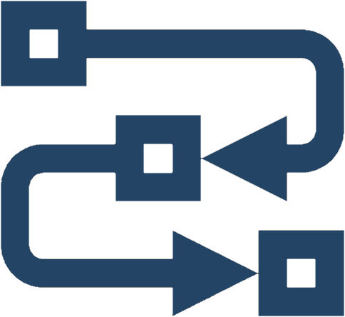
Methods
Defining and Using Methods
Softuni Team
Technical Trainers

Slide 2

Table of Contents
What Is a Method?
Declaring and Invoking Methods
Void and Return Type Methods
Methods with Parameters
Returning Values from a Method
Program Execution Flow
Naming and Best Practices

Slide 3
Have a Question?
sli.do
#prgm-for-qa

Slide 4

What Is a Method?
Void Methods

Slide 5
Simple Methods
Named block of code, that can be invoked later
Sample method definition:
Invoking (calling) the method several times:
Method named printHello
static void PrintHello ()
{
Console.WriteLine("Hello!");
}
Method body always surrounded by { }
PrintHello();
PrintHello();

Slide 6
Why Use Methods?
More manageable programming
Splits large problems into small pieces
Better organization of the program
Improves code readability
Improves code understandability
Avoiding repeating code
Improves code maintainability
Code reusability
Using existing methods several times

Slide 7
Void Type Method
Executes the code between the brackets
Void methods do not return a result
static void PrintHello()
{
Console.WriteLine("Hello");
}
Prints "Hello" on the console

Slide 8
{…}
Declaring and Invoking Methods
Define Your Own Methods and Invoke Them
Notes:
Add Image!

Slide 9
Declaring Methods
Variables inside a method are local
Return Type
Method Name
Parameters
static void PrintText(String text)
{
Console.WriteLine(text);
}
Method Body

Slide 10
Invoking a Method
Methods are first declared, then invoked (many times)
Methods can be invoked (called) by their name + ():
static void PrintHeader()
{
Console.WriteLine("----------");
}
Method Declaration
PrintHeader()

Slide 11
double
string
long
Methods with Parameters
Pass Input Data when Invoking Methods

Slide 12
Method Parameters
Method parameters can be of any data type
Call the method with certain values (arguments)
static void PrintNumbers(int start, int end)
{
for (int i = start; i <= end; i++)
{
Console.Write("{0} ", i);
}
}
Multiple parameters separated by comma
PrintNumbers(5, 10);
Passing arguments at invocation

Slide 13
Method Parameters (2)
You can pass zero or several parameters
You can pass parameters of different types
Each parameter has name and type
Multiple parameters of different types
Parameter type
Parameter name
static void PrintStudent(string name, int age, double grade)
{
Console.WriteLine("Student: {0}; Age: {1}, Grade: {2}",
name, age, grade);
}

Slide 14
Problem: Sign of Integer Number
Create a method that prints the sign of an integer number n:
2
The number 2 is positive.
-5
The number -5 is negative.
0
The number 0 is zero.

Slide 15
Solution: Sign of Integer Number
static void PrintSign(int number)
{
if (number > 0)
Console.WriteLine("The number {0} is positive", number);
else if (number < 0)
Console.WriteLine("The number {0} is negative.", number);
else
Console.WriteLine("The number {0} is zero.", number);
}

Slide 16
Problem: Grades
Write a method that receives a grade between 2.00 and 6.00 and prints the corresponding grade in words
2.00 - 2.99 ➡ "Fail"
3.00 - 3.49 ➡ "Average"
3.50 - 4.49 ➡ "Good"
4.50 - 5.49 ➡ "Very good"
5.50 - 6.00 ➡ "Excellent"
3.33
Average
4.50
Very good
2.99
Fail

Slide 17
Solution: Grades
double grade = double.Parse(Console.ReadLine());
PrintInWords(grade);
static void PrintInWords(double grade)
{
string gradeInWords = "";
if (grade >= 2 && grade <= 2.99)
gradeInWords = "Fail";
//TODO: make the rest
Console.WriteLine(gradeInWords);
}

Slide 18
Problem: Printing Triangle
Create a method for printing triangles as shown below:
1
1 2
1 2 3
1 2 3 4
1 2 3
1 2
1
1
1 2
1 2 3
1 2
1
3
4

Slide 19
Solution: Printing Triangle (1)
Create a method that prints a single line, consisting of numbers from a given start to a given end:
static void PrintLine(int start, int end) {
for (int i = start; i <= end; i++) {
Console.Write(i + " ");
}
Console.WriteLine();
}

Slide 20
Solution: Printing Triangle (2)
Create a method that prints the first half (1..n) and then the second half (n-1…1) of the triangle:
Method with parameter n
static void PrintTriangle(int n) {
for (int line = 1; line <= n; line++)
PrintLine(1, line);
for (int line = n - 1; line >= 1; line--)
PrintLine(1, line);
}
Lines 1...n
Lines n-1…1

Slide 21
Returning Values From Methods
Functions: Take Input, Calculate, Return a Result

Slide 22
The Return Statement
The return keyword immediately stops the method's execution
Returns the specified value
Void methods can be terminated by just using return
static string ReadFullName()
{
string firstName = Console.ReadLine();
string lastName = Console.ReadLine();
return firstName + " " + lastName;
}
Returns a string

Slide 23
Using the Return Values
Return value can be:
Assigned to a variable
Used in expression
Passed to another method
int max = GetMax(5, 10);
double total = GetPrice() * quantity * 1.20;
int age = int.Parse(Console.ReadLine());

Slide 24
Problem: Calculate Rectangle Area
Create a method which returns rectangle area with given width and length
3
4
6
8
12
48
5
10
7
8
50
56

Slide 25
Solution: Calculate Rectangle Area
int width = int.Parse(Console.ReadLine());
int length = int.Parse(Console.ReadLine());
int area = CalcRectArea(width, length);
Console.WriteLine(area);
static int CalcRectArea(int w, int l)
{
return w * l;
}

Slide 26

Program Execution Flow
The Call Stack: How Does It Work?

Slide 27
Program Execution
The program continues, after a method execution completes:
Console.WriteLine("before method executes");
PrintLogo();
Console.WriteLine("after method executes");
static void PrintLogo()
{
Console.WriteLine("Company Logo");
Console.WriteLine("http://www.companywebsite.com");
}

Slide 28
Program Execution – Call Stack
"The stack" stores information about the active subroutines (methods) of a computer program
Keeps track of the point to which each active subroutine should return control when it finishes executing
call
Call Stack
call
Main
Method A
Main
Method A
Method B
Start
Method B
return
return

Slide 29
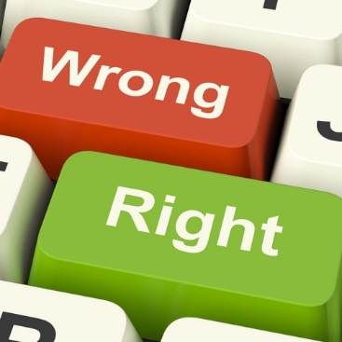
Naming and Best Practices
Good Method Name Explains What It Does

Slide 30


Naming Methods
Methods naming guidelines
Use meaningful method names
Method names should answer the question:
What does this method do?
If you cannot find a good name for a method, think about whether it has a clear intent
FindStudent, LoadReport, Sine
Method1, doSomething, HandleStuff, sample

Slide 31
Naming Method Parameters
Method parameters names
Preferred form: [Noun] or [Adjective] + [Noun]
Should be in camelCase
Should be meaningful
Unit of measure should be obvious
firstName, report, usersList, font
speedKmH, fontSizeInPixels, inchesLength

Slide 32
Methods – Best Practices
Each method should perform a single, well-defined task
A method's name should describe that task in a clear and non-ambiguous way
Avoid methods longer than one screen
Split them to several shorter methods
private static void printReceipt() {
PrintHeader();
PrintBody();
PrintFooter();
}
Self documenting and easy to test

Slide 33

Summary
…
…
…
Break large programs into simple methods that solve small sub-problems
Methods consist of declaration and body
Methods are invoked by their name + ()
Methods can accept parameters
Methods can return a value or nothing (void)

Slide 34









Questions?

Slide 35













SoftUni Diamond Partners

Slide 36
Trainings @ Software University (SoftUni)
Software University – High-Quality Education, Profession and Job for Software Developers
softuni.bg, about.softuni.bg
Software University Foundation
softuni.foundation
Software University @ Facebook
facebook.com/SoftwareUniversity
Software University Forums
forum.softuni.bg
Notes:
36

Slide 37

License
This course (slides, examples, demos, exercises, homework, documents, videos and other assets) is copyrighted content
Unauthorized copy, reproduction or use is illegal
© SoftUni – https://about.softuni.bg/
© Software University – https://softuni.bg
Notes:
37

